Slide 1
SMART GUJARAT FOR NEW INDIA HACKATHON 2019-20
Team id : SGH001825
Problem id: SGH074
Team leader: Mirza Nida Javidbeg
Number of Team members: 4
Member-1: Bombaywala Rukhsar Asfakhusen
Member-2: Dave Yesha Prafullkumar
Member-3: Karamchandani Trupti Vijaykumar
Industry: Government Polytechnic, Palanpur

Slide 2
Problem Statement : Digital Platform For Book sharing
Challenge Description :
Alumni, Senior students and Faculty members can donate their unused books or stationary materials to newly enroll students.
Platform should be capable of showing data of books and its photos.
Capable of showing data of donor and donee.
Able to reduce communication gap between senior and junior.

Slide 3
Need of this platform :
The main purpose of the project is to provide a common platform for the particular Institute so that they can share their old unused books to each other and communication gap between senior students and junior students can be reduced.
Other benefit of this project is that , unused books and stationary material can be used by needy students.

Slide 4
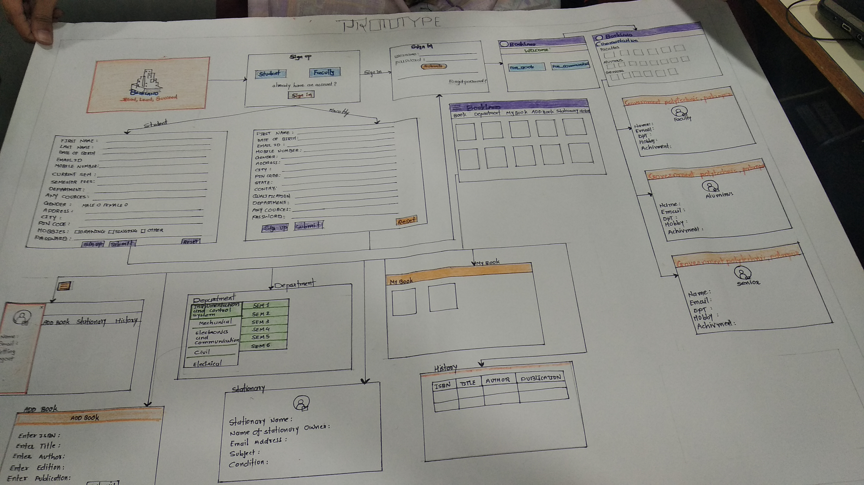
Prototype:

Slide 5
Video:
https://drive.google.com/open?id=1rpkJj_1-fXMbONO6hDRCbAetwD2qXhJE

Slide 6
Thank You

